Slide 1
Big Data Analytics Change Management Process
Based on the LION Change Management Process to address the following:
CCB Decision to Move Forward to Development
New or Change Business Capabilities (MMPs/Features/User Stories) Identified
Additions that increase Risks to Deliverables
CCB Decision to Move Forward to Development
Priority Changes for Business Capabilities (MMPs or Features)
Changes that increase Risks to Deliverables
CCB Decision to Move Forward to Development
New or Changed Features or User Stories (Design Defects – Severity 1, 2, 3)
Fixes that increase Risks to Deliverables
CCB Awareness Only
New or Changed Features or User Stories (Design Defects – Severity 1, 2, 3)
Fixes that do NOT increase Risks to Deliverables

Slide 2
Change Request Form
CR Form should be used when there is a CHANGE to the established base-line.
Changes with SIGNIFICANT IMPACT will be reviewed for CCB Decision
SIGNIFICANT IMPACT is defined as:
New or Missed Business Scenarios
Priority Changes (from one release to another)
Design Defects (Severity 1, 2, 3)
Point Changes to Products or within Teams (+/-10% or greater)
Changes will be categorized as Small, Medium, Large, or X-Large
All Changes will be tracked in CAAC
Weekly Points comparisons reflect changes AFTER those changes have already been made in CAAC

Slide 3
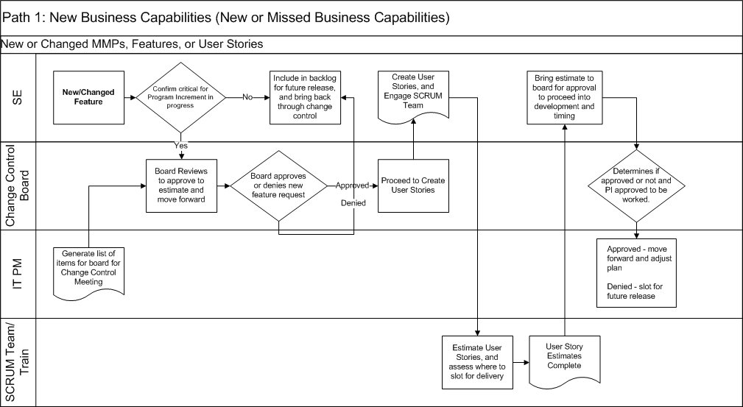
Change Control Path 1

Slide 4
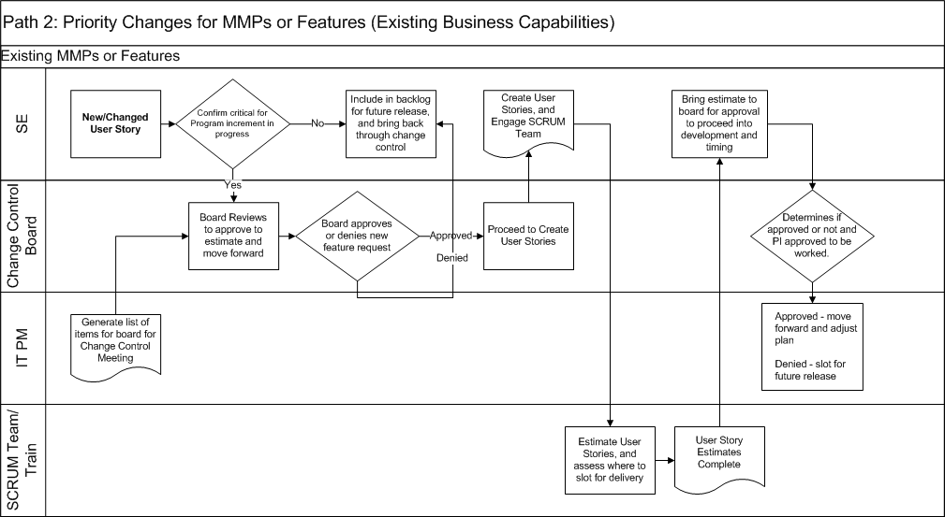
Change Control Path 2

Slide 5
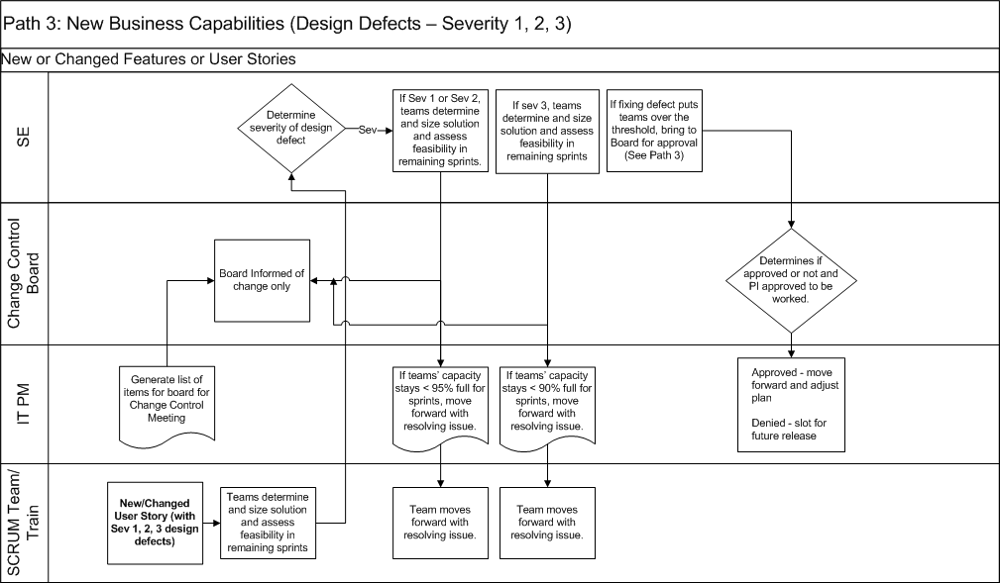
Change Control Path 3

Slide 6
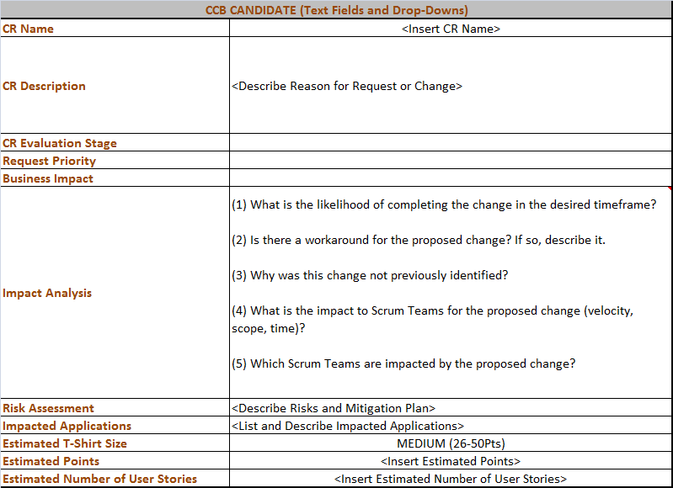
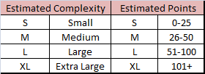
CR Form – CCB Submission
CR Form should be used when there is a CHANGE to the established base-line
CR Evaluation Stage
Impact Analysis
Delivery
Request Priority
Critical (CCB Decision Required)
Normal (CCB Decision Required)
Desired
Informational
Business Impact
Operations
Revenue
Estimate T-Shirt Size
See below

